Slide 1
Chapter 10

Slide 2
Objectives

Slide 3
Objectives (continued)

Slide 4
Two ways to create a function

Slide 5
How to specify parameters in a function

Slide 6
How to call a function

Slide 7
Terms

Slide 8
A primitive type is passed to a function by value

Slide 9
An object is passed to a function by reference

Slide 10
Terms

Slide 11
Global and local scope

Slide 12
Function declarations are created before any code is executed

Slide 13
Variables created inside a block of code can be used outside the block

Slide 14
Terms

Slide 15
Some popular JavaScript libraries

Slide 16
How to include JavaScript libraries in your application

Slide 17
The benefits of JavaScript libraries

Slide 18
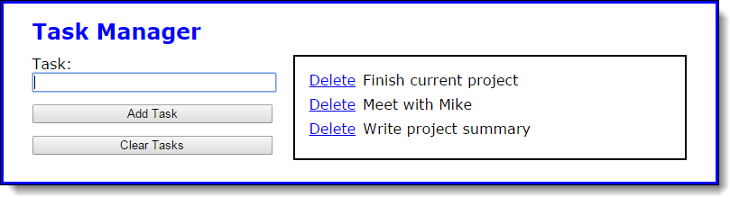
The user interface for the Task Manager application

Slide 19
The HTML for the application

Slide 20
Some of the CSS for the application

Slide 21
The library_storage.js file

Slide 22
The library_tasklist.js file

Slide 23
The library_tasklist.js file (continued)

Slide 24
The library_tasklist.js file (continued)

Slide 25
The task_list.js file

Slide 26
The task_list.js file (continued)

Slide 27
A function that uses the arguments property to get an argument

Slide 28
How to determine the number of arguments that have been passed

Slide 29
Calling a function with fewer arguments than the named parameters

Slide 30
Calling a function with more arguments than the named parameters

Slide 31
The this keyword

Slide 32
A function that uses the this keyword

Slide 33
How to invoke the thisTest function using the call and apply methods

Slide 34
How to use the call method to borrow methods from another object

Slide 35
How to use the bind method to set the this keyword for a function

Slide 36
How to use the bind method to set the this keyword for an event handler

Slide 37
Without the bind method, ‘this’ refers to the button that was clicked

Slide 38
With the bind method, ‘this’ refers to the circle object

Slide 39
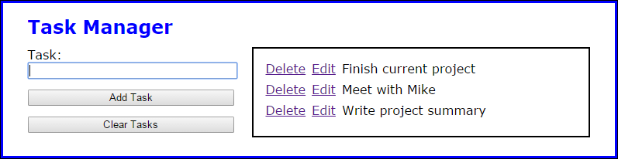
Exercise 10-1 Enhance the Task Manager app

Slide 40
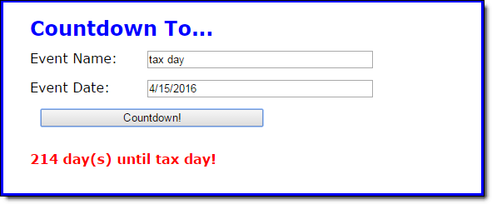
Extra 10-1 Convert CountDown app to functions

Slide 41
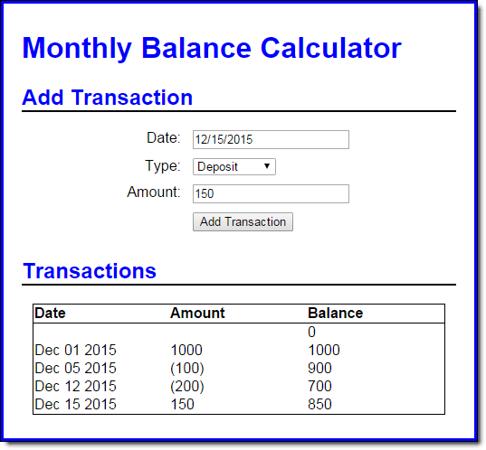
Extra 10-2 Develop the Monthly Balance app

Slide 42
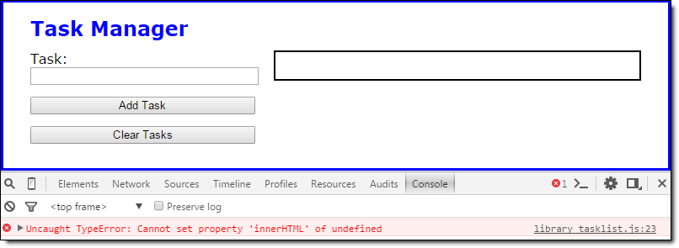
Short 10-1 Use the arguments property

